Slide 1
Segmentation targets
Pericytes
Club cells
Ciliated cells
Bronchioles
Acinar tubules
To be continued…

Slide 2
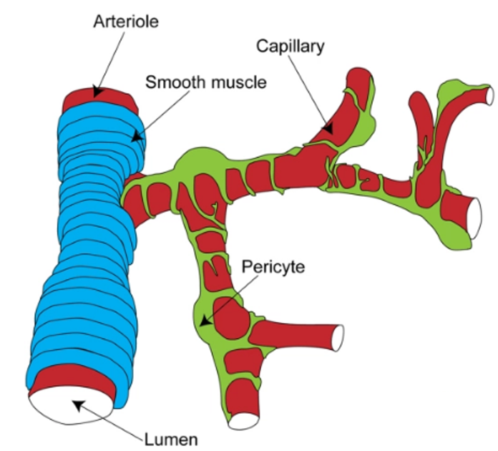
Pericytes
Notes:
Blood vessels are composed of two interacting cell types. Endothelial cells form the inner lining of the vessel wall, and perivascular cells—referred to as pericytes, vascular smooth muscle cells or mural cells—envelop the surface of the vascular tube.
pericytes: wrap around the endothelial cells of capillaries and venules throughout the body Function: vessel maintenance and vessel growth

Slide 3
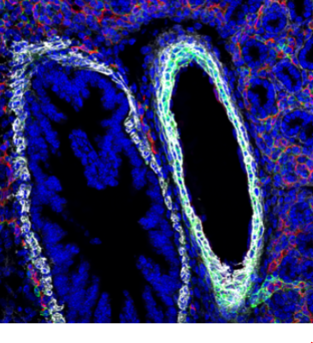
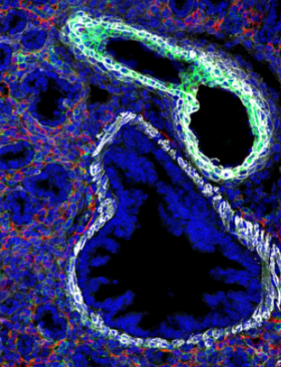
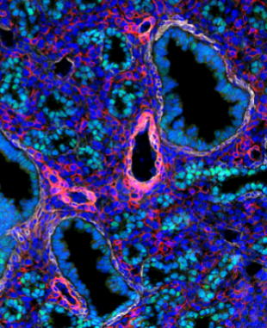
Pericytes
ACTA2
Emcn
NG2
ACTA2
TTF-1
NG2
Notes:
“Commonly used pericyte markers include platelet-derived growth factor receptor beta (PDGFRβ), chondroitin sulphate proteoglycan 4 (also known as nerve/glial antigen 2 or NG2), desmin and alpha-smooth muscle actin (αSMA) ”
Ref: http://www.ncbi.nlm.nih.gov/pmc/articles/PMC3768328/
“these markers can come and go over time”
Desmin and vimentin are similar but appears in different developmental stage
Emcn : marker for endothelium cells
Ttf-1: epithelium cells, club cells, ciliated cells, pneumocytes
I would consider everything appears green in first 2 images, and pink in 3rd image is pericyte.

Slide 4
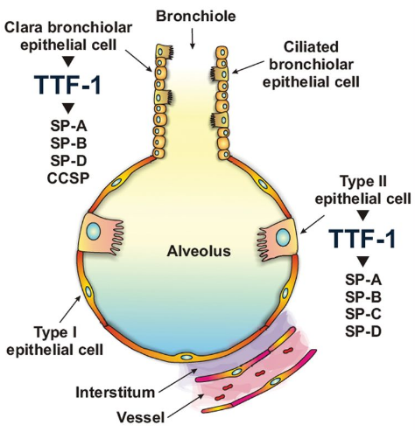
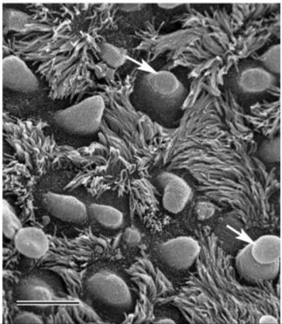
Ciliated cells and Club (Clara) cells
Notes:
Club cell are found in bronchiolar epithelium
secrete surfactant to protect bronchioles
can regenerate itself, and can differentiate into ciliated cells.
simple cuboidal epithelium, consisting of ciliated cells and non-ciliated club cells
Cliliated cells work to trap inhaled foreign particles

Slide 5
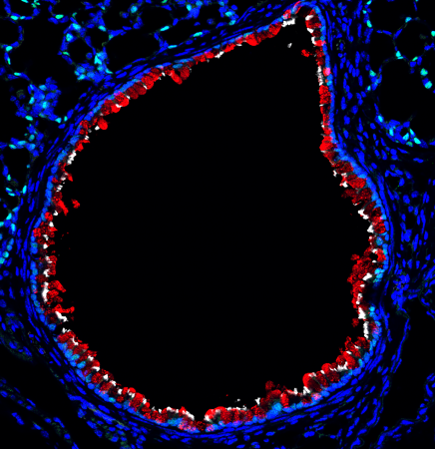
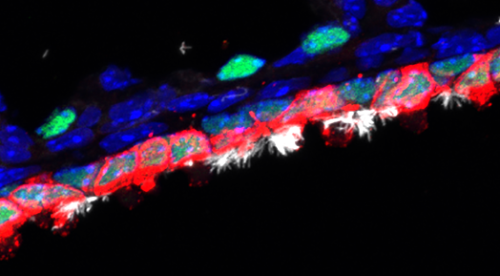
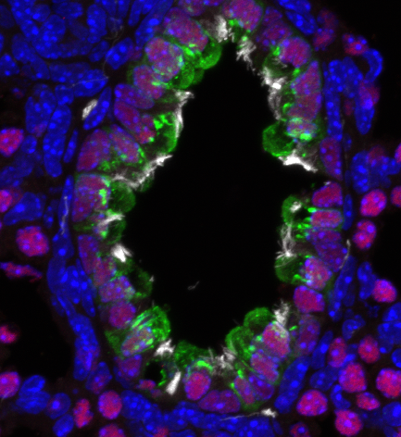
Ciliated cells and Club (Clara) cells
Tuba1a
CCSP
TTF-1
Tuba1a
CCSP
TTF-1
Notes:
Tuba1a: tubulin alpha-1A, marker for cilia
CCSP: club cells secretory protein
TTF-1 is expressed by alveolar type II and Clara epithelial cells and regulates the expression of SP and CCSP by these cells. In distal bronchiole, they are also expressed in ciliated cells
TTF-1 also marker for type I and II pneumocytes, epithelium cells, etc
I would consider the first inner layer of cells to be the combination of ciliated cells and club cells.

Slide 6
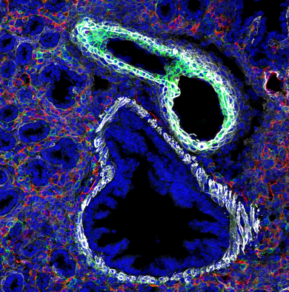
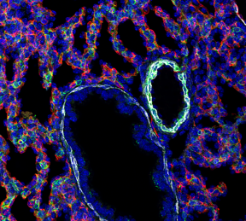
Bronchiole (E16.5, E18.5)
ACTA2
Emcn
NG2
Notes:
Bronchioles in early stage, E16.5 and E18.5 seem clear to me.

Slide 7
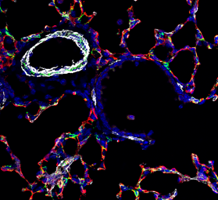
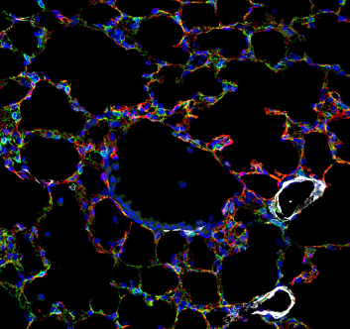
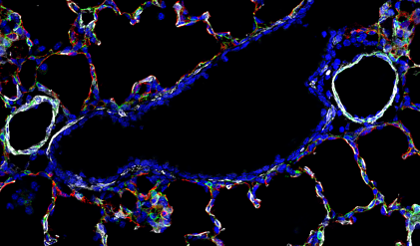
Bronchiole (P07, P14, P28)
ACTA2
Emcn
NG2
Notes:
However, bronchioles in post natal days are questionable for me. Are the blue circles showed above all bronchioles? Rule for bronchiole might be “big blue circle, adjacent to blood vessels”?
(DAPI (blue), a stain for DNA, will mark all nucleus. )

Slide 8
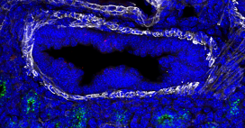
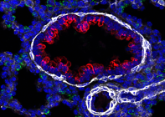
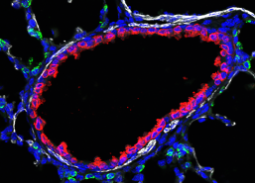
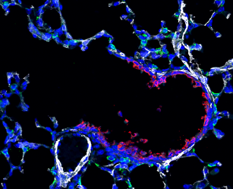
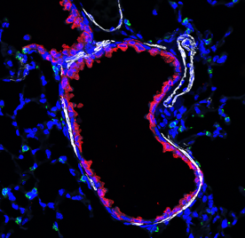
Bronchiole (E16.5, E18.5)
E16.5
E18.5
P07
P14
P28
ACTA2
CCSP
Sftpc
Notes:
If it is stained with CCSP (marker for club cells), it will be easier for us to locate bronchiole at different stages, since club cells usually are found in bronchiolar epithelium.

Slide 9
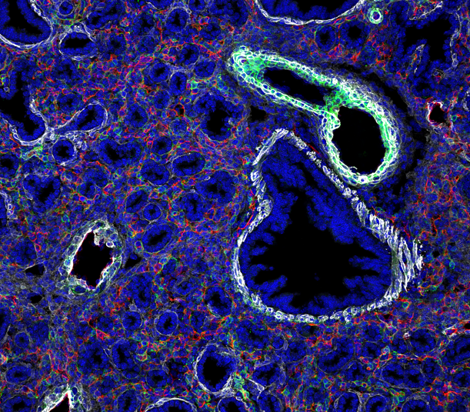
Acinar tubule is complicated
ACTA2
Emcn
NG2
Notes:
A good amount of images are not marked with a good acinar tubule marker. We may either ignore them, or let experts help us to define them by “shape”, etc. For instance, all the small blue rings in the image showed here might be acinar tubules?

